Slide 1
If statements and Loops
By Dane Lowrey

Slide 2
More Data Types
Boolean values are TRUE or FALSE values.
Example: the expression 5 == 5 would return the Boolean value TRUE
Example: the expression 5 > 6 would return the Boolean value FALSE
Arrays are comma separated lists of things
Example: [1,2,3,4,5] is an array of the numbers 1 – 5
Example: [“apple”, “orange”, “potato”] is a list of strings
Example: [“apple”, 1, “orange”, 2, true, false, “potatoes”] is an array of ints, Booleans, and strings!

Slide 3
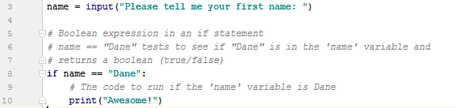
The IF statement
The IF statement controls on whether one part of a program gets executed, or another based on a condition given to it.
The block of code associated with the IF statement will be run if the condition in the statement is TRUE
The IF statement has a Boolean expression in it that will return a true or false value denoting whether or not to run the block of code.

Slide 4
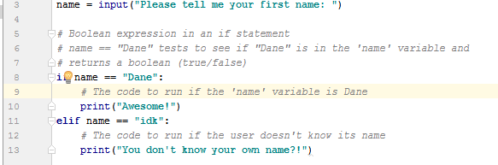
The ELIF statement
ELIF statement comes after an IF statement
ELIF stands for “Else If” and is another conditional statement that will run if its Boolean expression is true, just like the IF statement. The only difference is, it is after the IF statement, or another ELIF statement always.
“IF this then that, ELIF this then this, ELIF this then this, ELIF……”

Slide 5
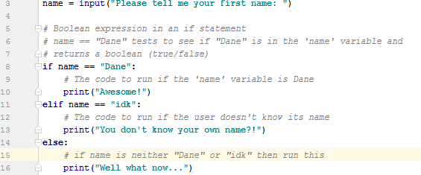
The ELSE statement
ELSE follows right after an IF or ELIF and is like the “otherwise do this” statement.
The ELSE statement has no conditional Boolean expression, it runs its block of code if the preceding IF or ELIF conditional Boolean expressions all return false.

Slide 6
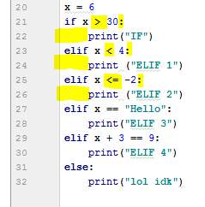
Remember…
IF and ELIF must always have a Boolean expression to evaluate off of. Boolean operators are things like greater than (>) less than (<) equal to (==) and things like that, as well as functions that return Boolean values.
ELSE does not need a Boolean expression to evaluate, and instead runs it’s code if the above IF and ELIF statements are not true.
IF, ELIF, and ELSE statements are all followed by a colon : at the end, and the blocks of code they would run are indented 4 spaces. This is where python’s spacing comes into play.
ONLY ONE of the blocks of code in a IF/ELIF/ELSE will run. In the previous example, only one of the print statements will ever get executed each time the program is run.

Slide 7
Try it out
Write a program called SimpleCalc that will take two numbers as input, as well as a “+”, or a “-” . You will get these inputs using three separate input statements, and store them using three separate variables.
The program will then look at the last input (the + -) and using if statements decide whether to add the two numerical inputs, or subtract them and print out the result. If the third input is neither of these, it will print “idk”
DON’T FORGET TO CAST YOUR INPUT AND COMMENT YOUR CODE
ALGORITHM:
Prompt user for input of 1st number, cast it
Prompt user for input of 2nd number, cast it
Prompt user for input of +, -
Decide whether to add, subtract using if and elif statements
Otherwise (else) print “idk”

Slide 8
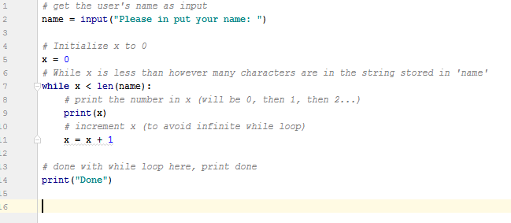
WHILE loops
Pretty simple, WHILE something is true , do this stuff
A WHILE loop keeps executing the same block of code over and over until it’s Boolean expression is false.
While loops are generally used when you don’t know or aren’t sure how many times you will need to execute a block of code.
The while loop also adheres to python’s 4 space indentation for the block of code it will run. Anything that is NOT indented is considered not to be part of the loop

Slide 9
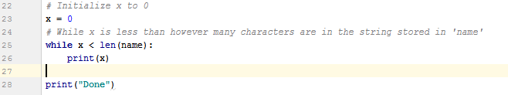
WHILE loop pitfall
An infinite while loop is a while loop that never terminates. It continues to run its block of code because the Boolean expression it evaluates is always true.
Generally your computer will speed up and stuff and then yeah it can cause bad things depending on what code its running over and over.
Here is an example of an infinite while loop:

Slide 10
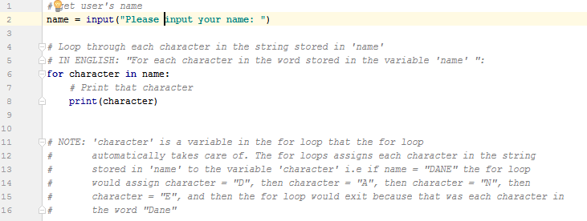
FOR loop
FOR each student at tech: do something
For statements are used for looping through something a certain amount of times.
For loops are generally used when you know exactly how many times you need to execute a block of code.
Note: you could use a while loop to do this as well. The idea is when using a for loop you know exactly how many times it will loop, and when using a while loop you are unsure if it will loop 5 times or 500 times.

Slide 11
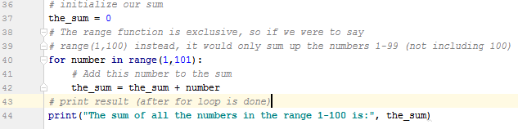
FOR loop
The for loop is often used to iterate (go through) a range.
If we wanted to write a program that would sum up the numbers between 1 and 100, we would use a for loop and sum each number in the range 1-100, and print out the result at the end.

Slide 12
Try it out
Write a program that takes in a number as input and then prints all of the numbers from 0 to that number INCLUSIVE using a while loop.
ALGORITHM:
Take in a number greater than 0 as input, cast it
Initialize a variable to test in a Boolean expression against the input number
Use the Boolean expression, the variable, and the input in a while statement
Hint: you need to make sure that the while loop will loop as many times as the number input!! Use <= (less than or equal to).
Print out the variable described in #2, and then increment it in the while loop’s code
Write the same program using a for loop now!

Slide 13
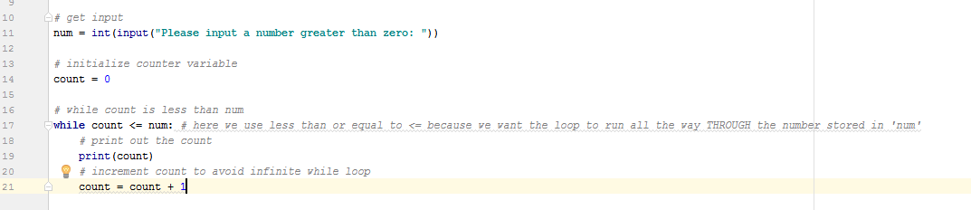
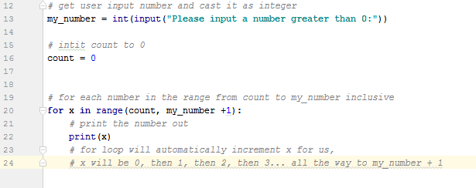
No worries if you couldn’t get it, loops can be a bit hard to grasp at first. Practice and you will be able to get the loops to do exactly what you want!

Slide 14
SecretMessage
Using IF, ELIF, ELSE statements combined with loops, we will write a program that will encrypt or decrypt a message!
Write a program called SecretMessage that will take in a message (encrypted or regular) and then take in a number (1 for encrypt, 2 for decrypt). Based on the number input, either encrypt the message given or decrypt it and display the resulting message.

Slide 15
Algorithm
Take in message as input
Take in 1 or 2 as input
If the number in #2 is 1, encrypt the message
If the number in #2 is 2, decrypt the message
Otherwise, print that the user has entered an invalid option.
Write the skeleton for this code!

Slide 16
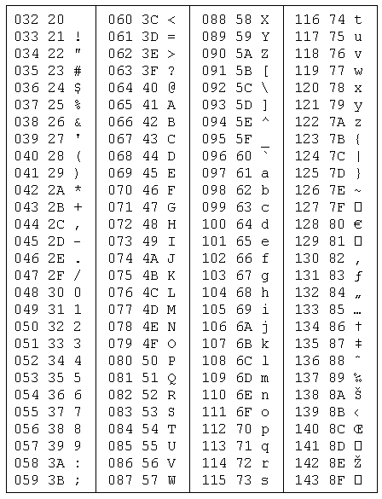
ASCII Values
ASCII stands for American Standard Code for Information Interchange
Big words for numbers that represent different characters on your keyboard.

Slide 17
Array Indexing
To retrieve a value in an array, you can use array indexing!
Example: say we have a list of numbers [1, 2, 3, 4, 5] in a variable called my_list and we want to get the number 4 and put it in the variable my_number
my_number = my_list[3]
my_list[3] will return the 3rd element in the list my_list. But wait? 4 is the 4th element in the list!!!
Wrong, kinda. Computers indexing numbers start at ‘0’. So my_list[0] would return the number 1, and so on.
You can ALSO do indexing with strings!!!

Slide 18
The ENCRYPTION Algorithm
Our encryption algorithm is simple:
Look at the message character by character
Convert the character to its corresponding ASCII value
Make a big string of just ASCII values representing the real message and print it out.
Keep in mind, we need to do this in our IF statement in the right place!
In python you can use casting to find the ASCII value of a string character!
ord(“s”) will return the ascii value of 73 as an integer!

Slide 19
The DECRYPTION Algorithm
Well now we have a huge string of numbers (ASCII values)
We need to look at each number and convert it back to its character representation….
Problem: ASCII values can be 2 digits long or 3 digits long, how will we know how many digits to take in to get the correct ASCII value?
Solution: any ASCII value that starts with the number “1” MUST be a 3 digit ASCII value, all others are 2 digits! We can use an IF statement to differentiate if we get a “1” or not!

Slide 20
The DECRYPTION Algorithm:
Initialize variable to empty string to hold our decrypted message
Initialize a variable x to control our while loop, and index the user’s message
While x is less than the length of the user’s message (use len(message))
Initialize a variable to hold the character we get from the ASCII value
Get the current character (use string indexing)
If the current character is “1”, we have a 3 digit ASCII value.
Get the next 2 digits and store them in variables
Concatenate all three variables and find the corresponding character representation of the ASCII value
Add the character to our decrypted message variable.
Increase x by 3 because we used 3 digits
Else the character is represented by 2 digits
Get the next digit
Concatenate those digits and get the corresponding character representation of the ASCII value created by them.
Add that character to our decrypted message variable
Increase x by 2 because we used 2 digits

